Slide 1
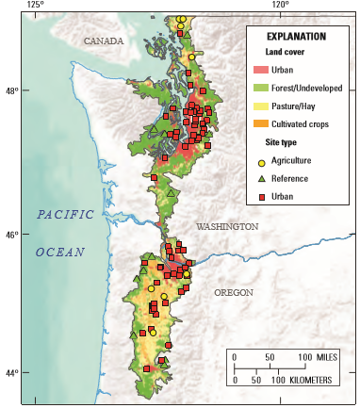
National Water-Quality Assessment Program
10 Week regional NAWQA study (April-June 2015); goals include:
Assess water and habitat quality
Quantify anthropogenic pollution
Determine impact on biological communities
Source: VanMetre, P.C., Morace, J.L., and Sheibley, Rich, 2015, The Pacific northwest stream quality assessment: U.S. Geological Survey Fact Sheet 2015–3020, 2 p., http://dx.doi.org/10.3133/fs20153020.
Notes:
Quick overview of National Water Quality Assessment Program
Regional study throughout the Puget sound looking at urban impacted perennial streams
Weekly water quality for 10 weeks April-June. Sampled water for pesticides, pharmaceuticals, metals, and persistant organics (ie PAHS, PCBS, Flame Retardants, etc.)
Ended with one time habitat assessment at all 88 sites. This included physical measures including slope and gradient, streambed composition, and benthic samples to assess bug community.
For the NW regions the USGS wanted to add a fish health component, to assess the potential impacts of urbanization on Salmonids.
Which is where this study comes in.
3/24/2016- revise to give NAQWA overview and how study fits within this framework
Notes on the talk 10/5/16:
Need to better describe why growth is important to measure: some thoughts…
Allometric growth is indicative of changes in environment (fish can both grow and shrink in response to environmental stress), integrates the conditions that fish over their growth period, growth is key to survival: significant in terrms of the amount of energy that is stored for the winter (low-feeding times), predetor avoidance, and response to stress (need to explain better). Size selective mortality later in life, food competition, etc.
Need to redo bioE simulations to incorporate the correct coho terms (get rid of rainbow trout juvenile terms), see the work by Dave, etc., need to get rid of fish that weren’t actually aged, add times to notes and organize.
Great a GLM that incorporates a number of factors, see notes for data matrix.

Slide 2
Key Fish Health Questions
Does increasing urbanization impact salmon health?
Can we mechanistically link toxicant exposure and stage specific growth?
Can we account for (distinguish between) anthropogenic and natural (near-term) influences on growth?
Notes:
Staying with the theme of the regional study, we sought to assess fish health across the urban gradient. These two question guide the focus of the study: Do juvenile salmon in urban streams exhibit increased/decreased expression of key detoxification genes which would get at the question of exposure. That is are fish being exposed to toxicants at a level that is effecting them at a physiological level. The second main question is: Is there evidence of impact to growth during the early life stage of salmon that can be linked to this toxicant exposure? That is to say, are salmon actually being harmed by this exposure. The gradient on the right represents the urban tiers we looked at as defined by landuse upstream of our sampleing points.

Slide 3
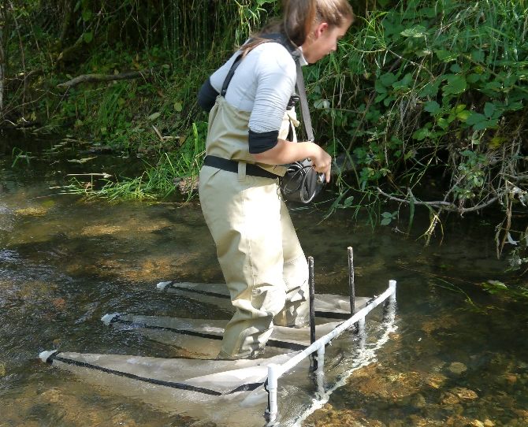
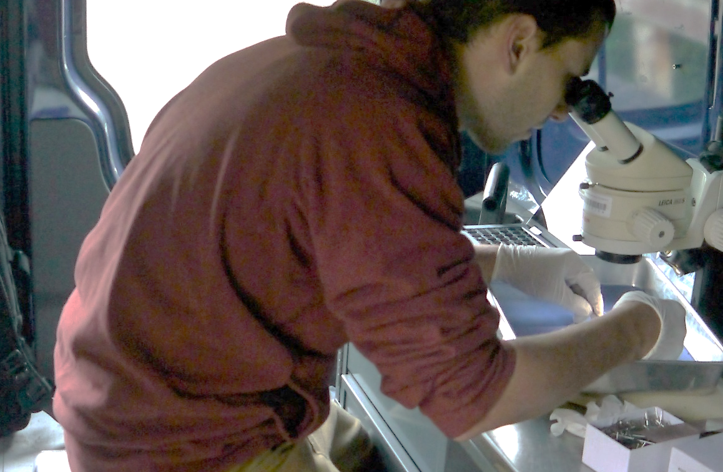
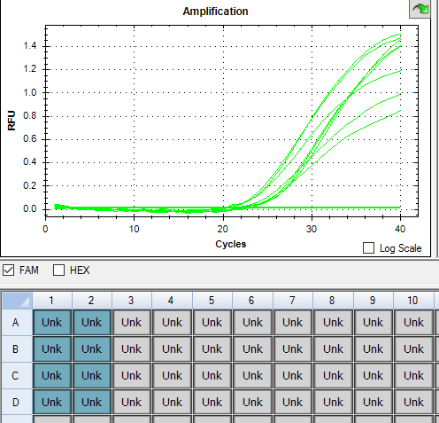
Two levels of assessment:
1) Resource availability and growth (bioenergetics) :
Energetics modeling to determine growth conditions
Accounting for: water temperature and food resources
2) Pollution Stress:
Toxicogenetic biomarker assessment
Water quality measures of toxicants
Notes:
Consider adding methods to this slide

Slide 4
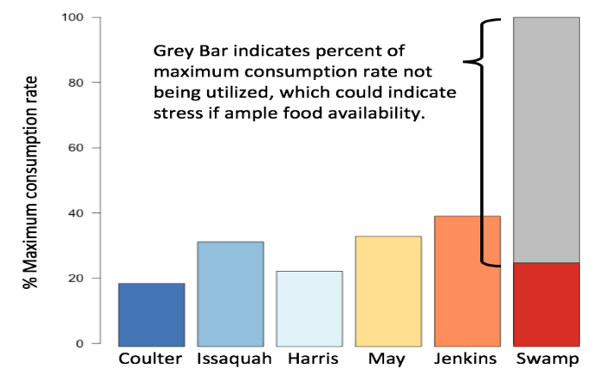
1) Resource availability and growth (Bioenergetics) Putting observed growth in the context of near-term conditions
Growth + Waste + Respiration = Consumption
Inputs:
Prey Quality/Prey Proportions
Temperature
Weight
Age
Diets and Drift
Temperature loggers
Measured
Otoliths
Notes:
Using a bioenergetics framework, we can model the relative consumption between sizes to achieve the observed growth using conditions unique at each site. If there is something effecting gowth outside these baseline conditions it will show up in the model as an unusually low consumption rate. Though not conclusive in the determination of growth effects due to toxicants, this work will help to determine if fish are growing at expected rates given tempical consumption rates determined from refrence sites and the literature.
Insert slide from energetics project in class…emphasize uncertainty
Metric of relative biomass of drift
Comparing food availability (drift) to modeled consumption
Consumption rate curves vs temperature (get excel file from Dave)
com

Slide 5
Drift/Diet Proportion- 10 sites June Drift: Diet:

Slide 6
Emergence Dates and Temperature
Site | Average Emergence Date
Coulter | 4/6/15
EF | 4/4/15
Issaquah | 3/20/15
Harris | 4/6/15
Church | 3/18/15
May | 3/28/15
Woodland | 2/28/15
Jenkins | 3/14/15
Longfellow | 3/21/15
Swamp | 3/15/15

Slide 7
Consumption Rate for fish sampled in June
N=10, except May creek (n=3),

Slide 8
Drift Proportions
August September

Slide 9
Consumption Rate for fish sampled in September
N=6 for each site

Slide 10
Drift Densities

Slide 11
Drift vs Cmax

Slide 12
Fish Counts June

